Slide 1
A shortcut to the genetic basis of Neurodegenerative Diseases
Lior Sivan Schapiro
Supervisors: Prof. Michal Linial and Roni Rasnic

Slide 2

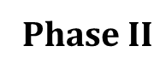
The Timeline
01
02
03
04
05
Biological Background
Phase $Ι$
Phase $ΙΙ$
Results
Future Work

Slide 3

01
Biological Background

Slide 4
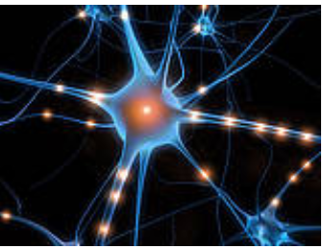


Neurodegenerative Diseases
Cells in the brain lose function over time and ultimately die
Examples- Alzheimer’s disease, Parkinson’s disease (PD), ALS
The risk of being affected increases dramatically with age

Slide 5
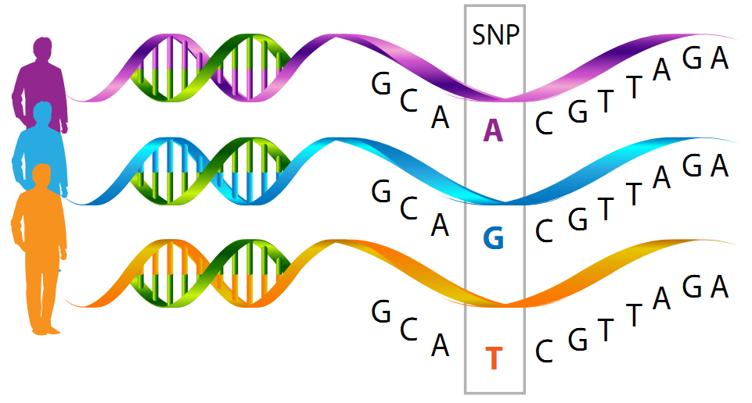
Constraint
A
A
Rank of genic functional intolerance to mutation variants using evolutionary conservation of protein sequences within species.
A
A
A
More than 150,000 human genomes (exomes) where tested
A
A
Notes:
Researches Examined more than 150,000 human genomes (exomes) looking for region that had less genetic variation that expected. These region are constraint
Observed/expected (oe) is a continuous measure of how tolerant a gene is to a certain class of variation (e.g. loss-of-function). When a gene has a low oe value, it is under stronger selection for that class of variation than a gene with a higher value.

Slide 6

אולי לתקן שאלה
02
Phase $Ι$
Can we learn from a healthy population about the genetic basis of Neurodegenerative Diseases?

Slide 7
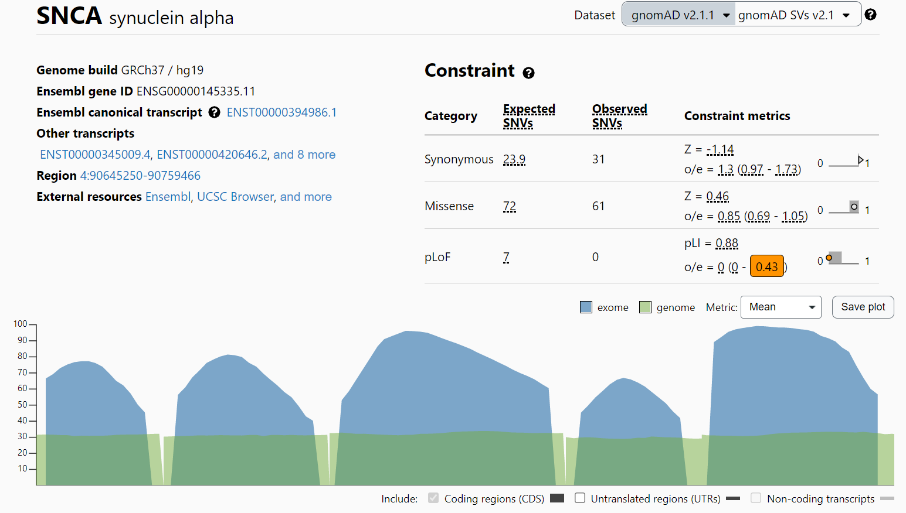
GnomAD data
change that doesn’t change the amino acid
change of a single nucleotide
changes that interrupt the protein function

Slide 8
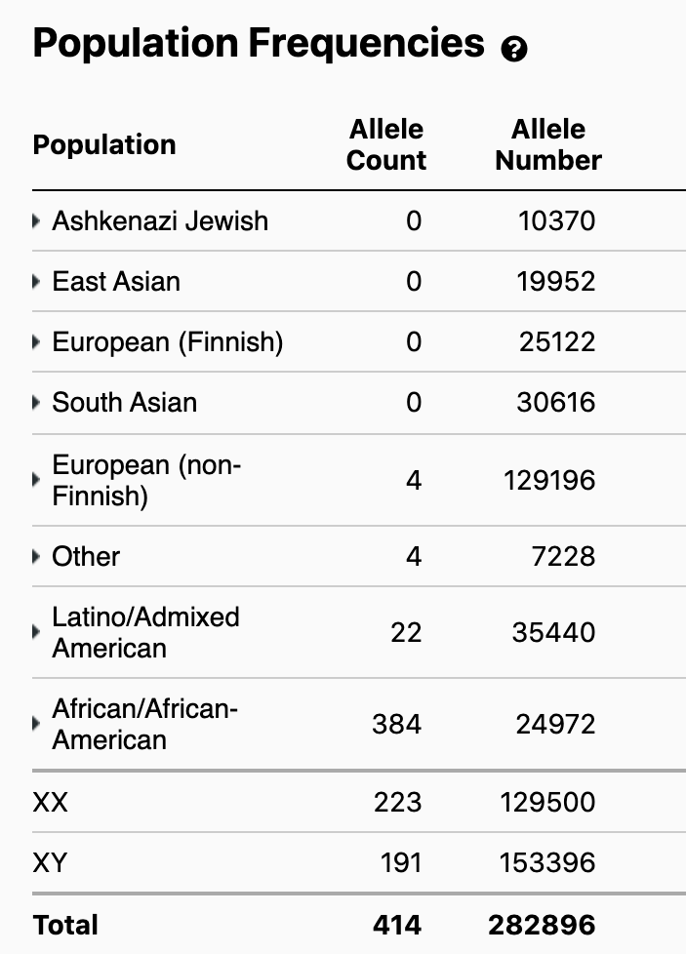
Re-calculation of the pLoF score – WHY?
0 : 10370
0 : 19952
1: 32299

Slide 9
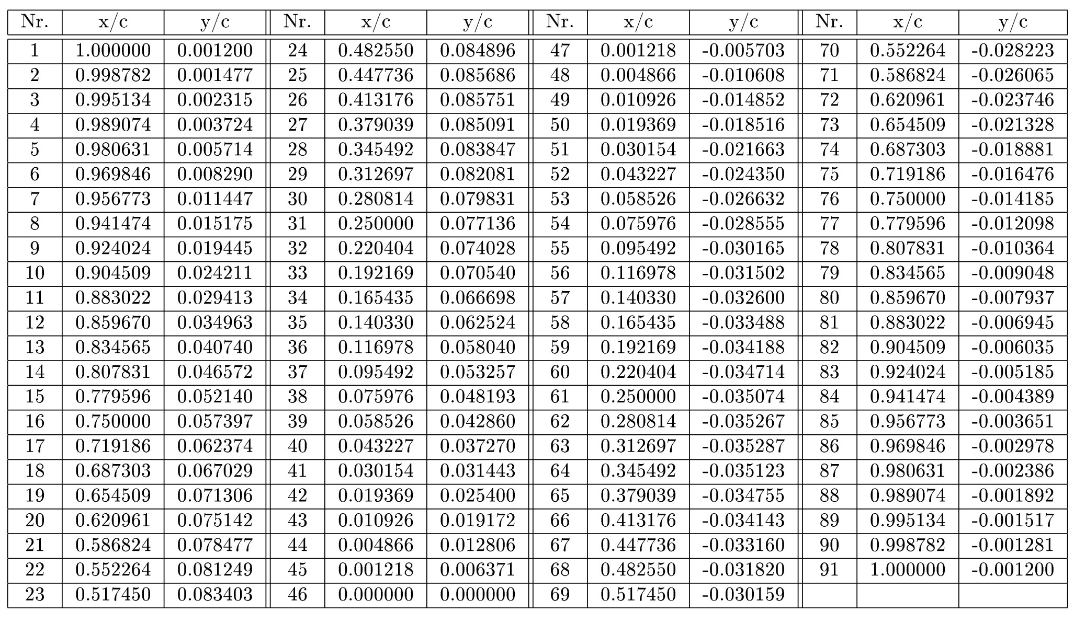
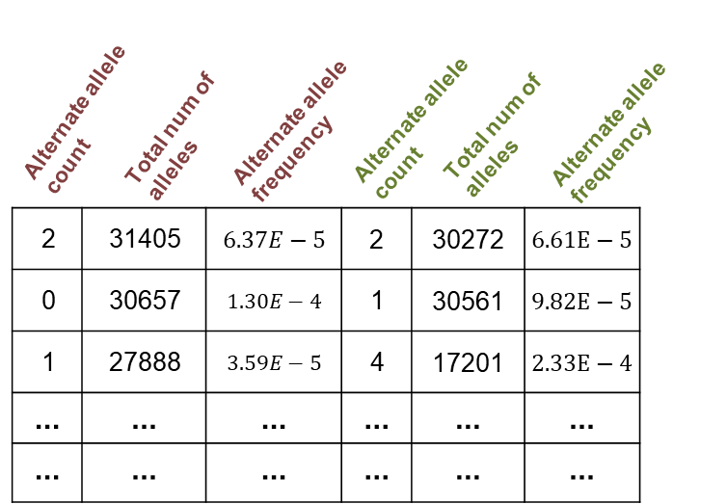
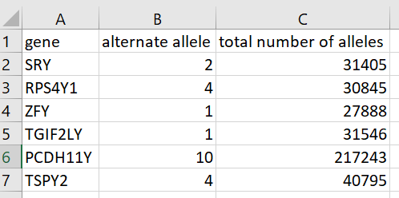
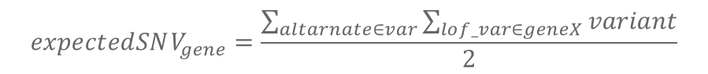

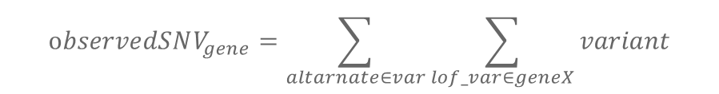



Re-calculation of the pLoF score
Chromosomal VCF files
Neuro candidates
All - non neuro
non neuro
$$var0_{geneX}$$
$$var1_{geneX}$$
$$var0_{geneY}$$
$$vars…$$
2 lists with 18k gene and their data
$$observedSNV_{gene}=\sum_{altarnate∈var}{\sum_{lof_var∈geneX}{variant}}$$
$$expectedSNV_{gene}=\frac{\sum_{altarnate∈var}{\sum_{lof_var∈geneX}{variant}}}{2}$$

Slide 10



Re-calculation of the pLoF score
עיצוב!!
$$observedSNV_{gene}=\sum_{altarnate∈var}{\sum_{lof_var∈geneX}{variant}}$$
Assumption
One of the PLOF mutation: transcript ablation
Splice acceptor variant
Splice donor variant
Stop gained frameshift variant
2 lists of 18,000 genes with their sum of alternate allele count and total number of allele count
Alternate allele > 0 $→$ total ++
$\frac{Total allele number}{2}$s.t every person has 1

Slide 11

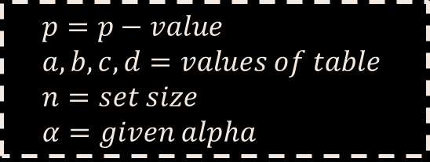
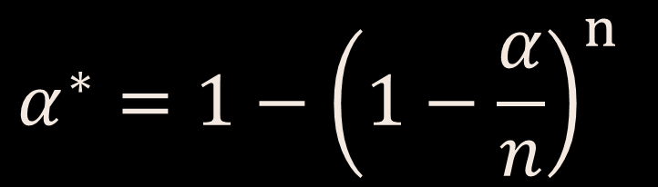
Fisher exact and Bonferroni Correction
עיצוב!!
$$p=\frac{\left(a+b\right)!\left(c+d\right)!\left(a+c\right)!\left(b+d\right)!}{a!b!c!d!n!}$$
$$α^{∗}=1−{\left(1−\frac{α}{n}\right)}^{n}$$
$$p=p−value \\ a,b,c,d=values of table \\ n=set size \\ α=given alpha$$
Notes:
used to examine the significance of the association (contingency) between the two kinds of classification
להסביר שפישר רץ עם הנחה שכל דגימה היא בת"ל לקודמת. ויש צורך בתיקון כי זה השוואות מרובות

Slide 12
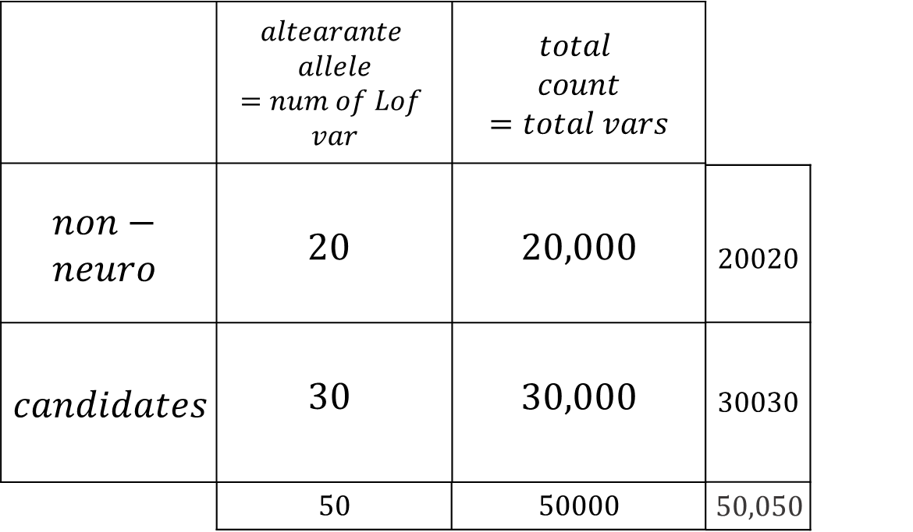

Using Fisher p-value as pLoF score
18k
genes
$$×$$
P-value
Notes:
in particular low oe values are indicative of strong intolerance.
On the other hand, a gene with an LoF oe of 0.4 can clearly be interpreted as a gene where only 40% of the expected loss-of-function variants were observed and therefore is likely under selection against LoF variants

Slide 13
Gene's constraint distribution of European
P-value = 1
P-value > 0.05
P-value < 0.05
P-value << 0.05
P-value = 0
Most of the genes have p-value = 1 $→$ can change and have number of variants

Slide 14
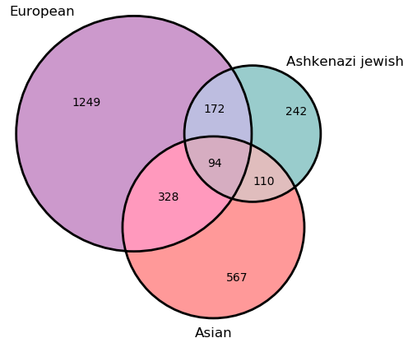
Constraint in different populations
European = 1249 Ashkenazi Jewish = 242 Asian = 567
94 overlap genes

Slide 15
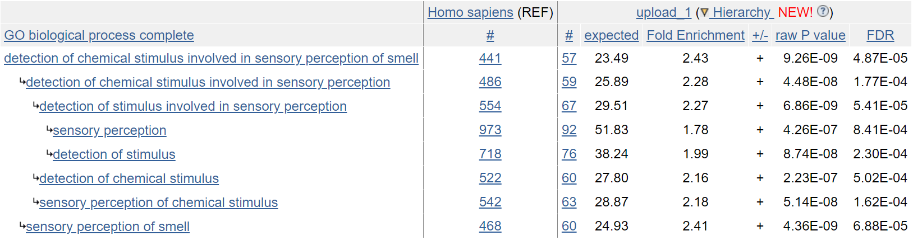
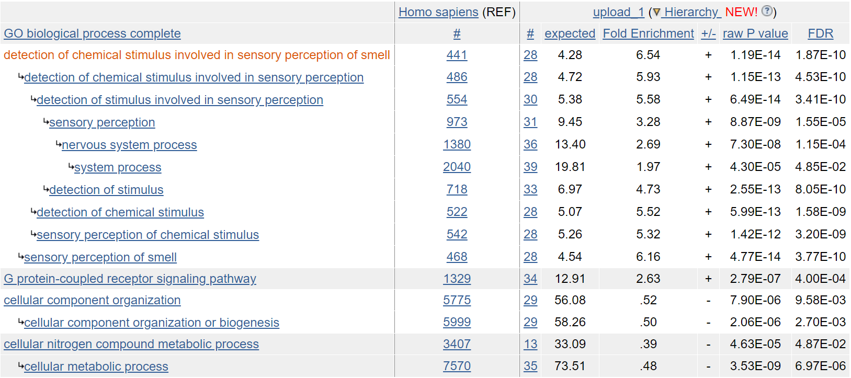
Ontology results of the most suspected genes

Slide 16

03
Phase $ΙΙ$
Can Early Onset of Complex Diseases
be a hint for Etiology?

Slide 17


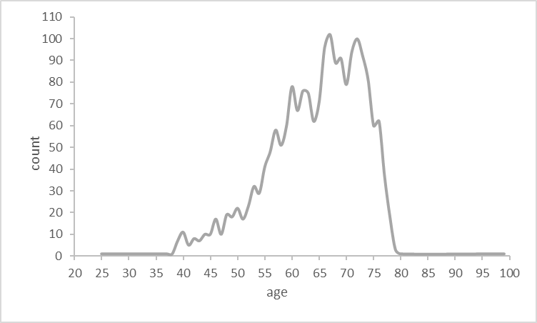
Parkinson in numbers
10M
people worldwide
Age distribution
60k
new cases every year
52B$
every year
60%
40%

Slide 18
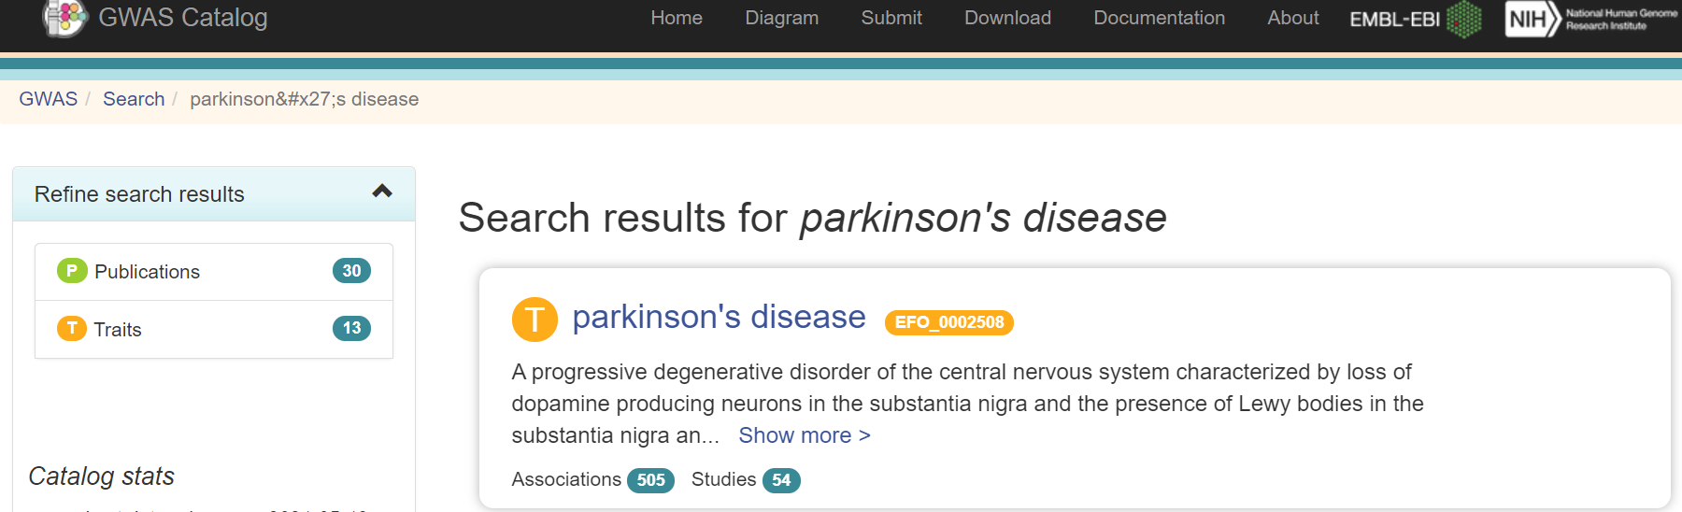
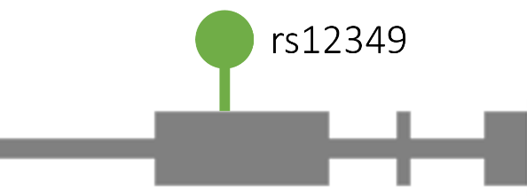

GWAS - genome wide association study
Genotype
Phenotype
AACGCTGCTAAT
Cohort
Notes:
https://www.ebi.ac.uk/gwas/search?query=parkinson%27s%20disease
מה חשוב להדגיש- זה דאטה אגריגטיבי בלי מחקר של אנשים רק נוכל להגיד מי שמור ומי לא.
We want to find link between variant and phenotype using cohort data.

Slide 19




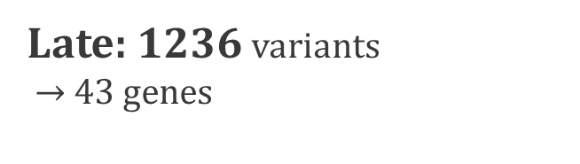
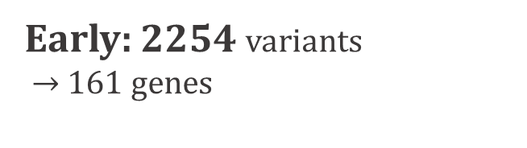
What data did we have from GWAS?
Late: 1236 variants $→$43 genes
Early: 2254 variants $→$161 genes
4 overlap genes (all are known as related)

Slide 20

FABRIC
(Functional Alteration Bias Recovery In Coding-regions)
Assess the impact of mutations on gene/protein function
Find genes more damaged than expected
Given this number of random mutations
Notes:
FABRIC (Functional Alteration Bias Recovery In Coding-regions) is a framework for detecting genes showing functional alteration bias in some evolutionary context. Highlight genes with mutations more damaging than expected
אז מה זה בעצם ציון סיגניפיקנטי? זה אומר שלא צפינו שהגן יפגע בעצמו בצורה שבה חישבנו

Slide 21
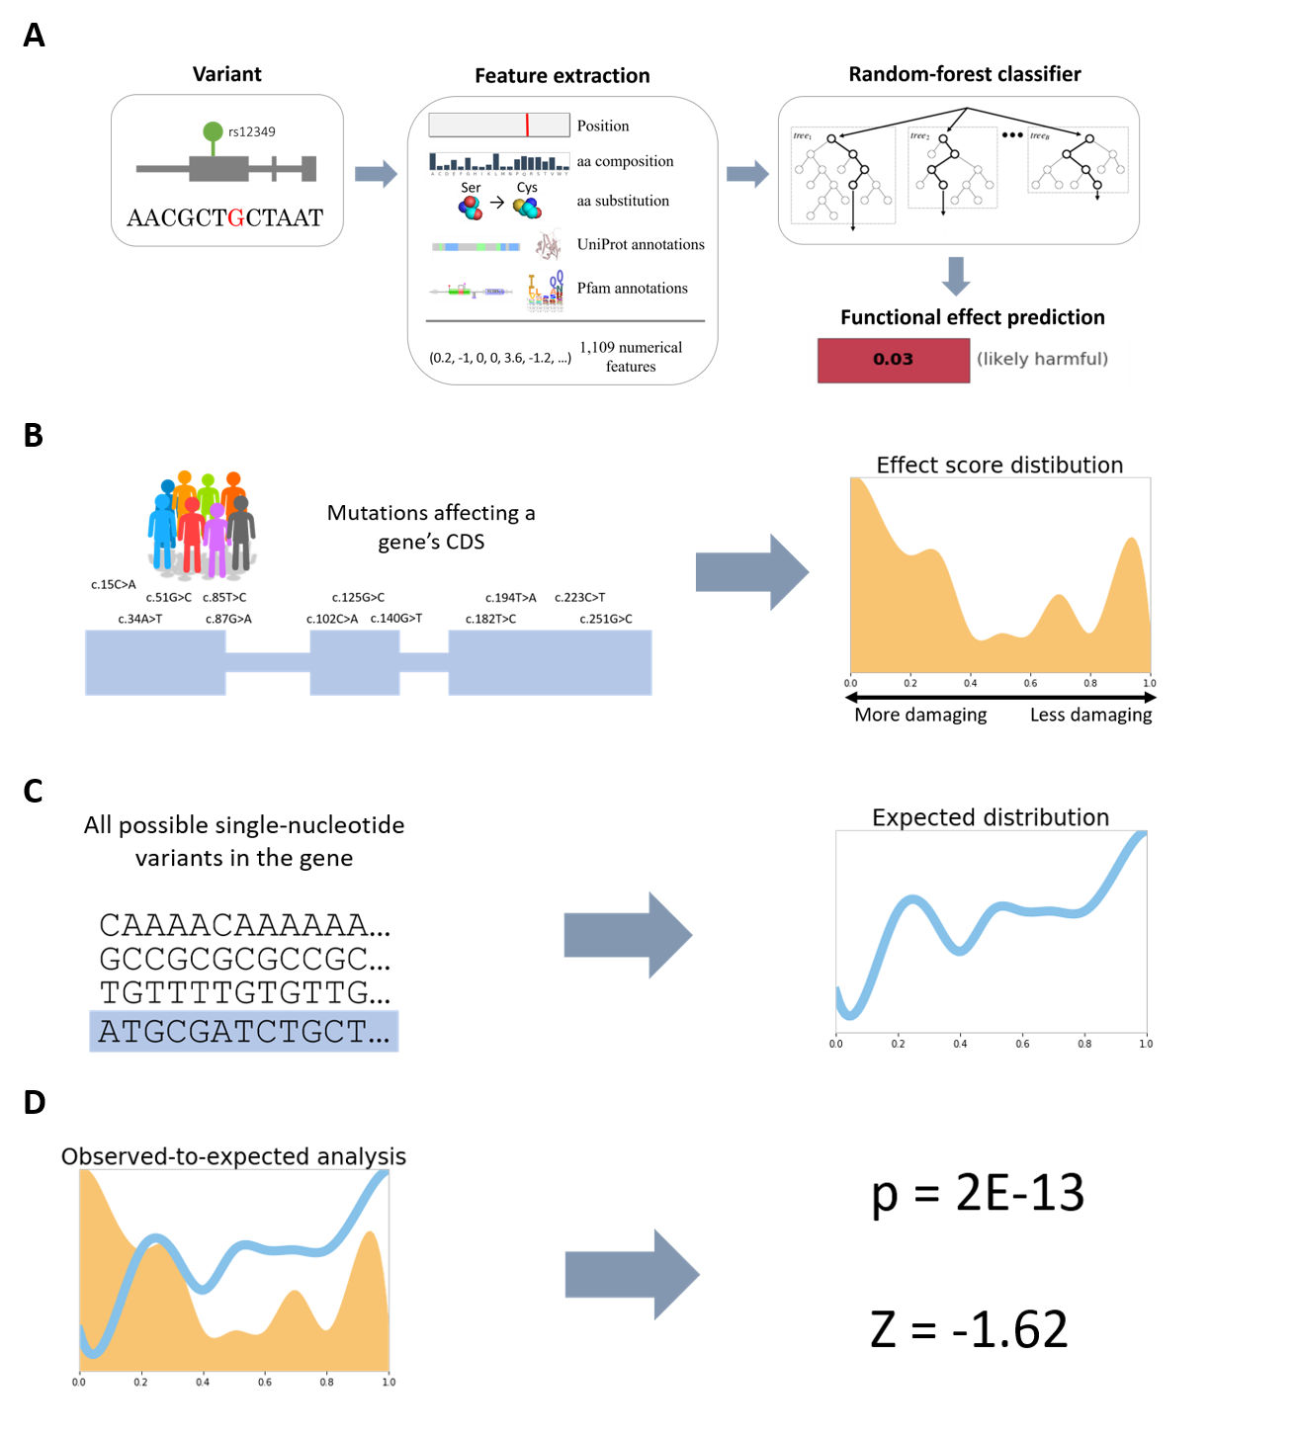
FABRIC
Notes:
ראשית נחשב את ההסתברות לכל ההחלפות של בסיסים אפשריים
נגיד החלפה של A ב-G. לאחר מכן ניקח את החלק בגן ונחליף כל A ב-G ונראה מה ההסתברות נריץ על האלגוריתם ונקבל ציון
נעשה החלפה בהסתברויות ושוב נריץ וכך נקבל מוטציה רנדומלית בגן ומה הסיכוי שלה
בסוף נשווה בין מה שראינו למה שהרצנו.

Slide 22
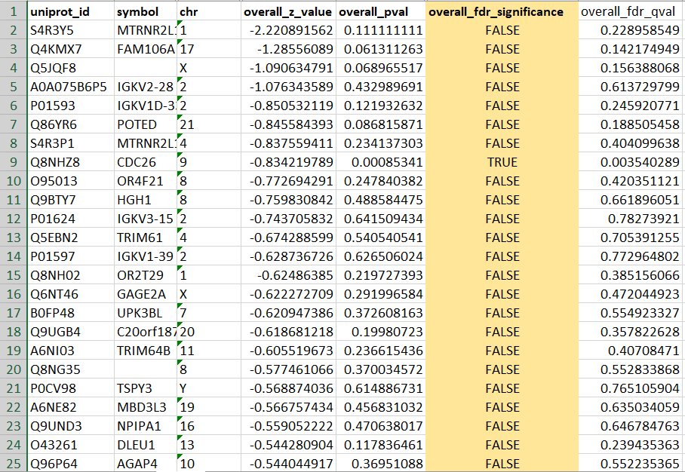
FABRIC output

Slide 23
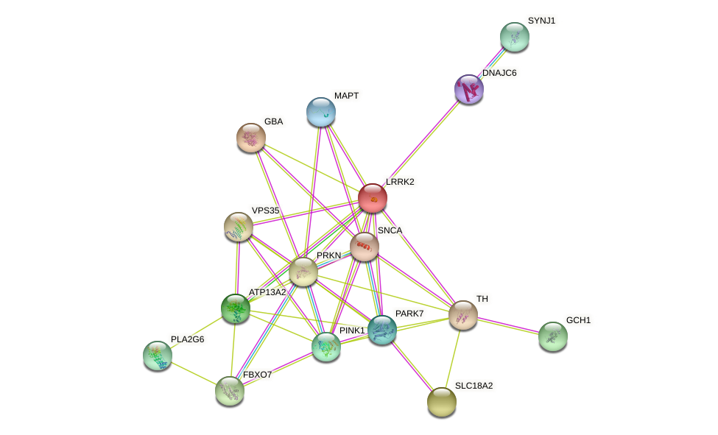
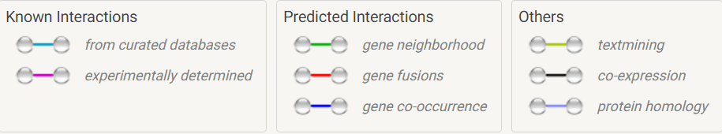
Network of Parkinson genes identified by FABRIC
25 genes were marked as “significant” (positive selection) for early onset, none for late onset

Slide 24

04
What’s Next?

Slide 25
What’s Next?
Run fabric on the 94 constraint genes
in order to test how damaged, they are.
Compare between other population & Run on more diseases like Alzheimer
Analyze exomes from UK bio-bank
& build predictor for individuals

Slide 26

Michal, Amir and Roni

Slide 27

Questions?

